Slide 1
Operating System
Lecture 2: Computer System Structure
Manoj Kumar Jain
M.L. Sukhadia University Udaipur

Slide 2
Outline
Computer System Operation
I/O Structure
Storage Structure
Storage Hierarchy
Hardware Protection
General System Architecture
Manoj Kumar Jain Professor Computer Science MLSU Udaipur

Slide 3
Computer-System Architecture
A CPU and a number of device controllers connected through a common bus that provides access to shared memory
Each device controller is in charge of a specific type of device
Manoj Kumar Jain Professor Computer Science MLSU Udaipur

Slide 4

Computer-System Architecture (Cont.)
Manoj Kumar Jain Professor Computer Science MLSU Udaipur

Slide 5
Computer-System Operation
I/O devices and the CPU can execute concurrently.
Each device controller has a local buffer.
CPU moves data from/to main memory to/from local buffers
I/O is from the device to local buffer of controller.
Device controller informs CPU that it has finished its operation by causing an interrupt.
Manoj Kumar Jain Professor Computer Science MLSU Udaipur

Slide 6
Common Functions of Interrupts
Interrupt transfers control to the interrupt service routine generally, through the interrupt vector, which contains the addresses of all the service routines.
Interrupt architecture must save the address of the interrupted instruction.
Incoming interrupts are disabled while another interrupt is being processed to prevent a lost interrupt.
A trap is a software-generated interrupt caused either by an error or a user request.
An operating system is interrupt driven.
Manoj Kumar Jain Professor Computer Science MLSU Udaipur

Slide 7
Interrupt Handling
The operating system preserves the state of the CPU by storing registers and the program counter.
Determines which type of interrupt has occurred:
  polling
  vectored interrupt system
Separate segments of code determine what action should be taken for each type of interrupt
Manoj Kumar Jain Professor Computer Science MLSU Udaipur

Slide 8
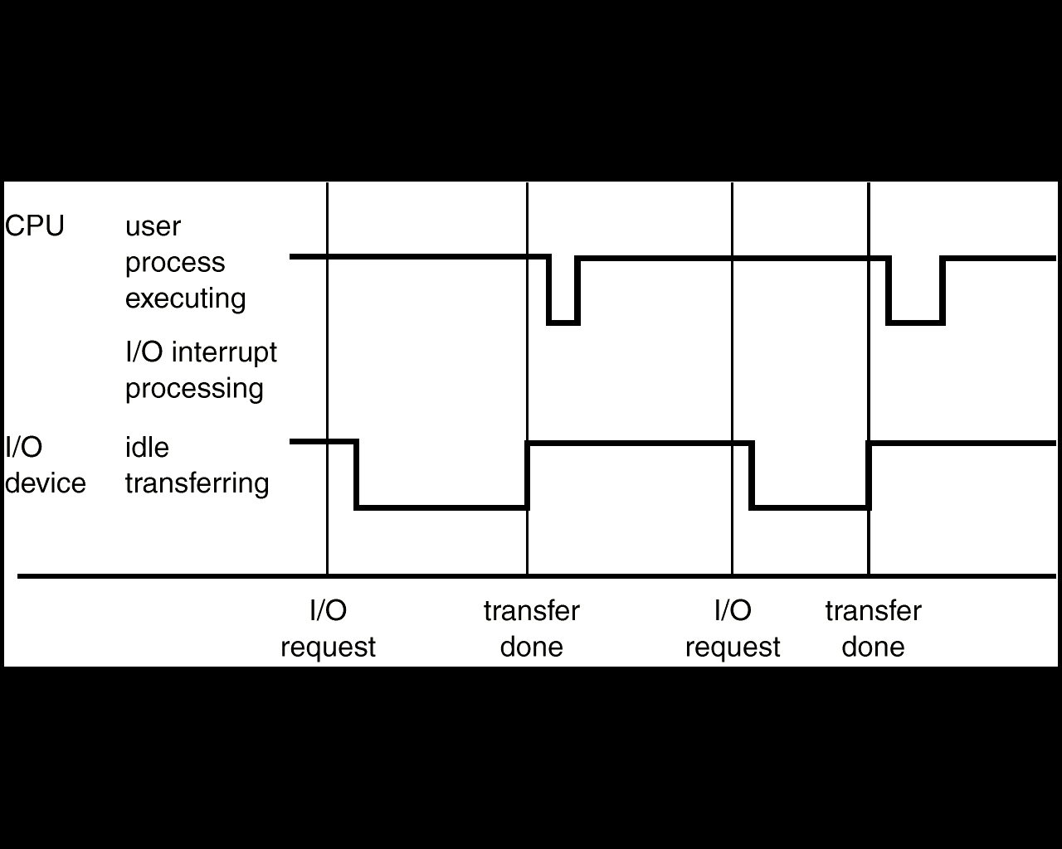
Interrupt Time Line For a Single Process Doing Output
Manoj Kumar Jain Professor Computer Science MLSU Udaipur

Slide 9
I/O Structure
After I/O starts, control returns to user program only upon I/O completion.
  Wait instruction idles the CPU until the next interrupt
  Wait loop (contention for memory access).
  At most one I/O request is outstanding at a time, no simultaneous I/O processing.
After I/O starts, control returns to user program without waiting for I/O completion.
  System call – request to the operating system to allow user to wait for I/O completion.
  Device-status table contains entry for each I/O device indicating its type, address, and state.
  Operating system indexes into I/O device table to determine device status and to modify table entry to include interrupt.
Manoj Kumar Jain Professor Computer Science MLSU Udaipur

Slide 10

Two I/O Methods
Synchronous
Asynchronous
Manoj Kumar Jain Professor Computer Science MLSU Udaipur

Slide 11

Device-Status Table
Manoj Kumar Jain Professor Computer Science MLSU Udaipur

Slide 12
Direct Memory Access Structure
Used for high-speed I/O devices able to transmit information at close to memory speeds.
Device controller transfers blocks of data from buffer storage directly to main memory without CPU intervention.
Only on interrupt is generated per block, rather than the one interrupt per byte.
Manoj Kumar Jain Professor Computer Science MLSU Udaipur

Slide 13
Direct Memory Access (Cont.)
CPU is free to perform other tasks when DMA controller is transferring data
DMA ‘steals’ memory cycles from CPU which may slowdown CPU
DMA controller interrupts the CPU when the transfer has been completed
Manoj Kumar Jain Professor Computer Science MLSU Udaipur

Slide 14
Storage Structure
Main memory – only large storage media that the CPU can access directly.
Secondary storage – extension of main memory that provides large nonvolatile storage capacity.
Magnetic disks – rigid metal or glass platters covered with magnetic recording material
  Disk surface is logically divided into tracks, which are subdivided into sectors.
  The disk controller determines the logical interaction between the device and the computer.
Manoj Kumar Jain Professor Computer Science MLSU Udaipur

Slide 15

Moving-Head Disk Mechanism
Manoj Kumar Jain Professor Computer Science MLSU Udaipur

Slide 16
Storage Hierarchy
Storage systems organized in hierarchy.
  Speed
  Cost
  Volatility
Caching – copying information into faster storage system; main memory can be viewed as a last cache for secondary storage.
Manoj Kumar Jain Professor Computer Science MLSU Udaipur

Slide 17

Storage-Device Hierarchy
Total storage capacity
Cost per bit and performance
Manoj Kumar Jain Professor Computer Science MLSU Udaipur

Slide 18
Caching
Use of high-speed memory to hold recently-accessed data.
Requires a cache management policy.
Caching introduces another level in storage hierarchy. This requires data that is simultaneously stored in more than one level to be consistent.
Manoj Kumar Jain Professor Computer Science MLSU Udaipur

Slide 19
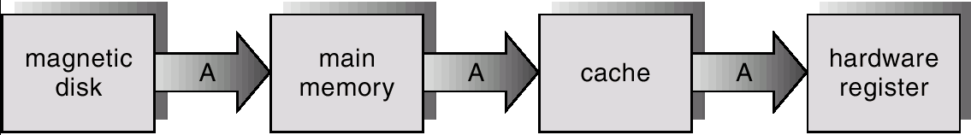
Migration of A From Disk to Register
Manoj Kumar Jain Professor Computer Science MLSU Udaipur

Slide 20
Hardware Protection
Dual-Mode Operation
I/O Protection
Memory Protection
CPU Protection
Manoj Kumar Jain Professor Computer Science MLSU Udaipur

Slide 21
Dual-Mode Operation
Sharing system resources requires operating system to ensure that an incorrect program cannot cause other programs to execute incorrectly.
Provide hardware support to differentiate between at least two modes of operations.
  1. User mode – execution done on behalf of a user.
  2. Monitor mode (also kernel mode or system mode) – execution done on behalf of operating system.
Manoj Kumar Jain Professor Computer Science MLSU Udaipur

Slide 22
Dual-Mode Operation (Cont.)
Mode bit added to computer hardware to indicate the current mode: monitor (0) or user (1).
When an interrupt or fault occurs hardware switches to monitor mode.
Interrupt/fault
monitor
user
set user mode
Privileged instructions can be issued only in monitor mode.
Manoj Kumar Jain Professor Computer Science MLSU Udaipur

Slide 23
Dual-Mode Operation (Cont.)
At system boot time the hardware starts in monitor mode
The operating system is loaded
Starts user processes in user mode
When a trap or interrupt occurs, hardware switches from user mode to monitor mode
Whenever os gains control of computer, it is in monitor mode. Mode switches to user mode before control is passed to user
Manoj Kumar Jain Professor Computer Science MLSU Udaipur

Slide 24
I/O Protection
All I/O instructions are privileged instructions.
Must ensure that a user program could never gain control of the computer in monitor mode (i.e., a user program that, as part of its execution, stores a new address in the interrupt vector).
Manoj Kumar Jain Professor Computer Science MLSU Udaipur

Slide 25

Use of A System Call to Perform I/O
To do I/O , user program executes
a system call to request that the
operating system perform I/O
on its behalf
OS executing in monitor mode,
Checks validity of request
Perform requested I/O, if valid req.
OS returns to user
Manoj Kumar Jain Professor Computer Science MLSU Udaipur

Slide 26
Memory Protection
Must provide memory protection at least for the interrupt vector and the interrupt service routines.
In order to have memory protection, add two registers that determine the range of legal addresses a program may access:
  Base register – holds the smallest legal physical memory address.
  Limit register – contains the size of the range
Memory outside the defined range is protected.
Manoj Kumar Jain Professor Computer Science MLSU Udaipur

Slide 27

Use of A Base and Limit Register
Manoj Kumar Jain Professor Computer Science MLSU Udaipur

Slide 28

Hardware Address Protection
Manoj Kumar Jain Professor Computer Science MLSU Udaipur

Slide 29
Hardware Protection
When executing in monitor mode, the operating system has unrestricted access to both monitor and user’s memory.
The load instructions for the base and limit registers are privileged instructions.
Manoj Kumar Jain Professor Computer Science MLSU Udaipur

Slide 30
CPU Protection
Timer – interrupts computer after specified period to ensure operating system maintains control.
  Timer is decremented every clock tick.
  When timer reaches the value 0, an interrupt occurs.
Timer commonly used to implement time sharing.
Time also used to compute the current time.
Load-timer is a privileged instruction.
Manoj Kumar Jain Professor Computer Science MLSU Udaipur

Slide 31
Network Structure
Local Area Networks (LAN)
Wide Area Networks (WAN)
Manoj Kumar Jain Professor Computer Science MLSU Udaipur

Slide 32
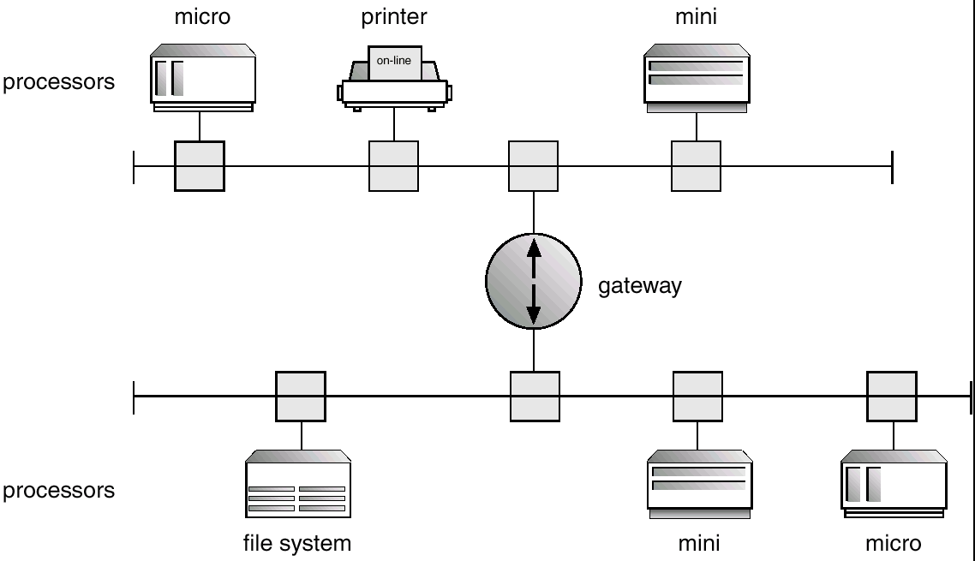
Local Area Network Structure
Manoj Kumar Jain Professor Computer Science MLSU Udaipur

Slide 33
LAN features
Cover small geographical area
Communication links tend to have higher speeds
High quality cables are used (twisted pairs and fiber optic)
Common configurations are multi access bus, ring and star networks
Manoj Kumar Jain Professor Computer Science MLSU Udaipur

Slide 34
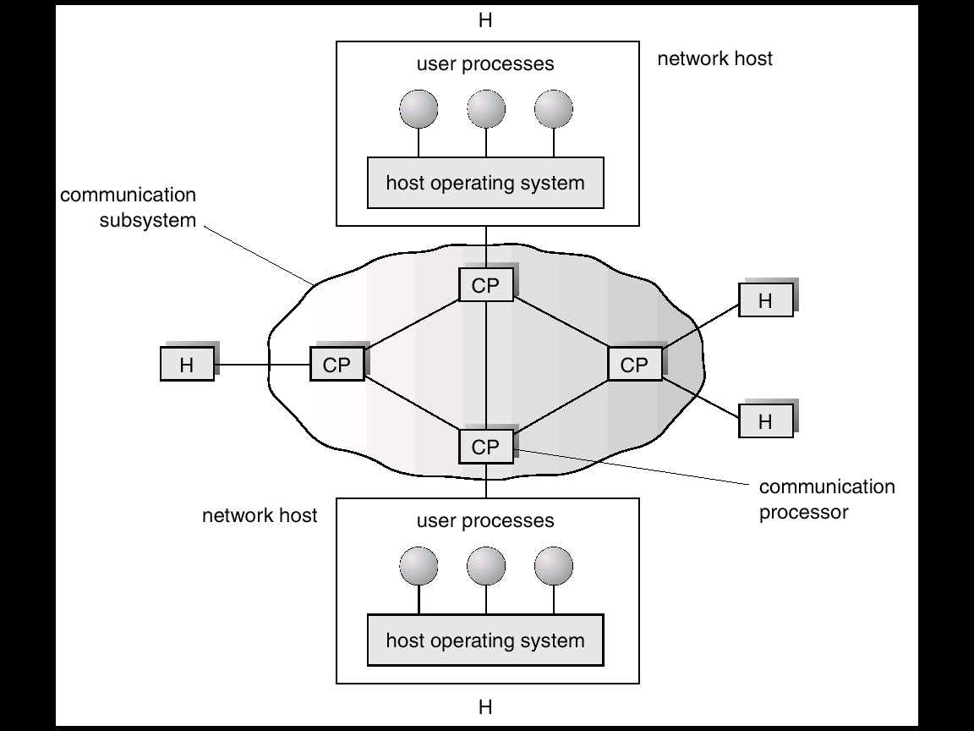
Wide Area Network Structure
Manoj Kumar Jain Professor Computer Science MLSU Udaipur

Slide 35
WAN features
Distributed over a large geographical area
Communication links are relatively slow and unreliable (telephone lines, lease lines, microwave links and satellite channels)
Communication links are controlled by communication processors which are responsible for defining the interface through which the site communicate over the network, as well as for transferring information among the various sites
Manoj Kumar Jain Professor Computer Science MLSU Udaipur

Slide 36
Thanks
Manoj Kumar Jain Professor Computer Science MLSU Udaipur

